Slide 1
Matrix Multiplication with CUDA
Robert Hochberg
2017.03.16
Taekyung Kim
Dept. of Mathematical Science, KAIST

Slide 2
Contents
Introduction
Memory Hierarchy
Registers & Shared Memory
Implementing in CUDA
Simple Matrix Multiplication
Matrix Multiplication with Shared Memory
Performance Comparison

Slide 3
Introduction

Slide 4
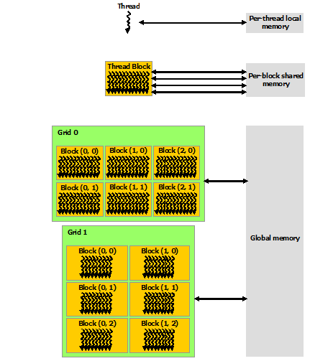
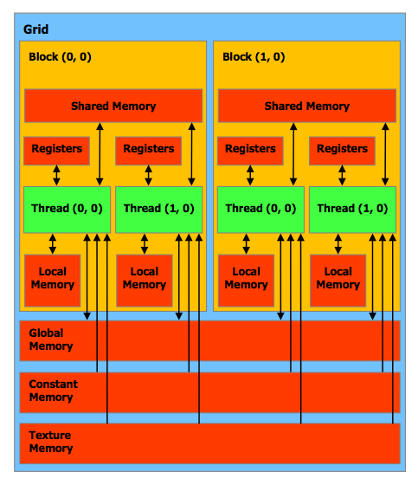
Memory Hierarchy

Slide 5
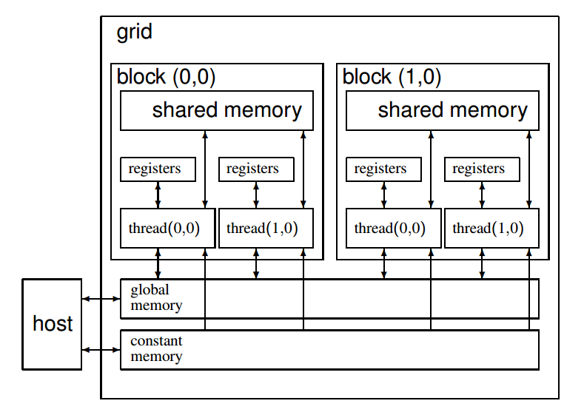
Registers & Shared Memory
Can allocate shared memory
with __shared__

Slide 6
Focus of Contents
Shared memory
can be accessed faster than Global Memory.
is limited
[Amount of shared memory per block]
GeForce 9400M :16,384 bytes
the Tesla C2050/C2070 : 49,152 bytes
the Tesla K20c and the P100 : 49,152 bytes
Compare the matrix multiplication with and without shared memory

Slide 7
Implementing in CUDA

Slide 8
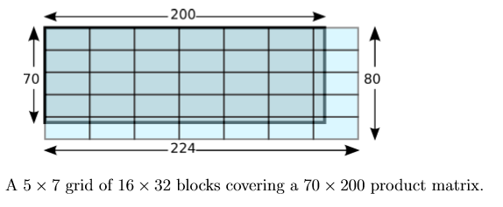
Simple Matrix Multiplication
Index Notation
gridDim | The dimensions of the grid. Use gridDim.x, gridDim.y and gridDim.z to access the dimensions. (In the example, gridDim.x = 7, gridDim.y = 5 and gridDim.z = 0. )
blockIdx | The location of a block within the grid.
blockDim | The dimensions of the blocks.
threadIdx | This structure gives the location of a thread within its own block. (The top-left thread of each block would ﬁnd threadIdx.x = threadIdx.y = threadIdx.z = 0, while the top-right threads would ﬁnd threadIdx.x = 31, threadIdx.y = 0 and threadIdx.z = 0.)

Slide 9
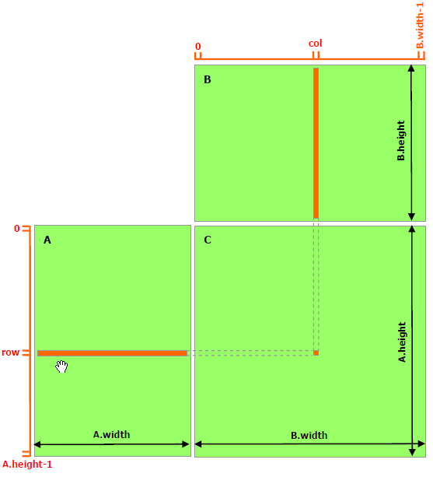
Simple Matrix Multiplication
Copy every data to global memory
Each thread will compute each component
by accessing global memory

Slide 10
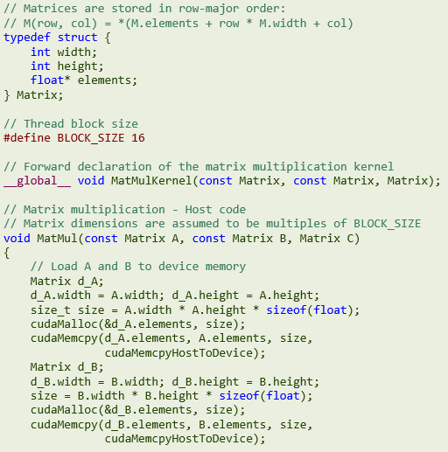
Simple Matrix Multiplication
Construct a matrix structure

Slide 11
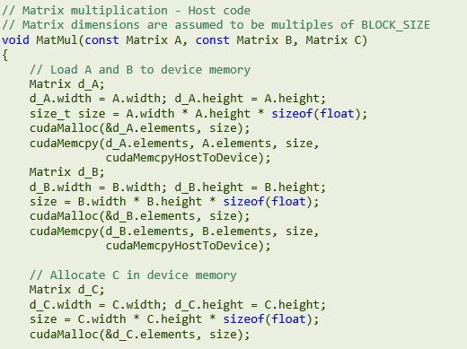
Simple Matrix Multiplication
Declare variables and fundamental setting

Slide 12
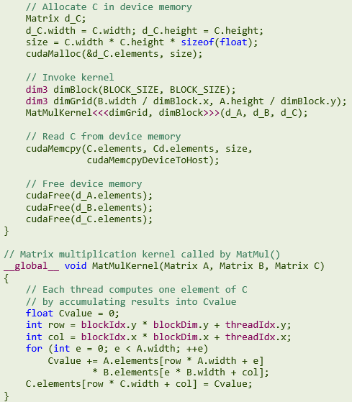
Simple Matrix Multiplication
Proceed GPU computation and free the variables
Matrix Multiplication function

Slide 13
Simple Matrix Multiplication

Slide 14
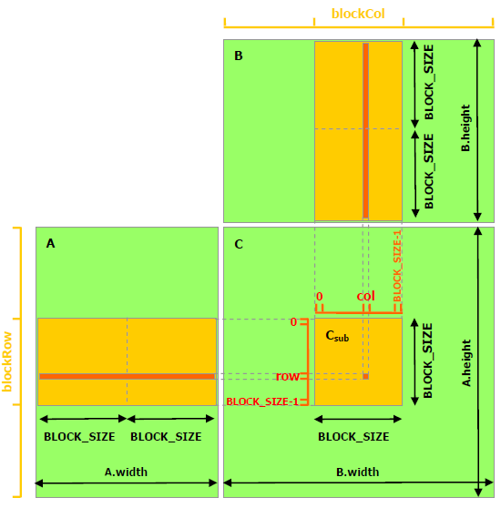
Matrix Multiplication using Shared Memory
Copy every data to global memory
Each shared memory will copy some portions of
input data necessary for submatrix computation
Block size determines the submatrix size

Slide 15
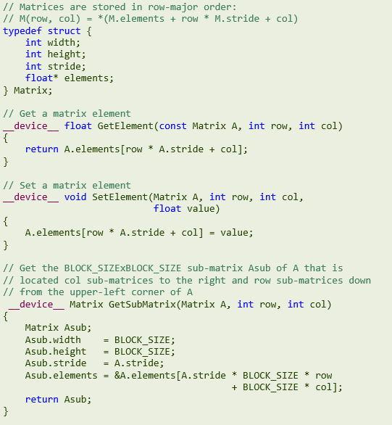
Matrix Multiplication using Shared Memory
Construct a matrix structure

Slide 16
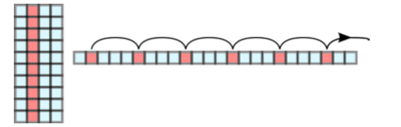
Matrix Multiplication using Shared Memory
Necessity for stride
For submatrices, the size of a step along column may not be the width of that submatrix

Slide 17
Matrix Multiplication using Shared Memory
Define a function obtaining submatrix

Slide 18
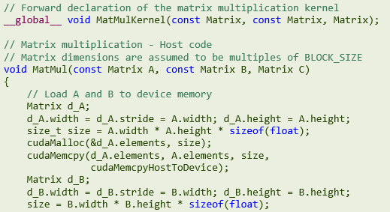
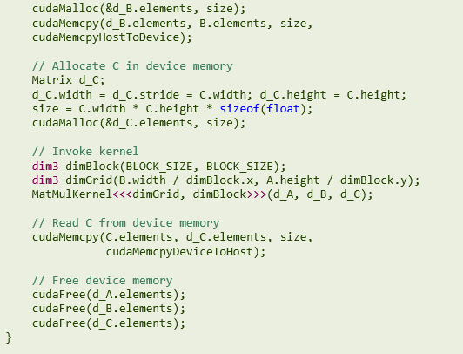
Matrix Multiplication using Shared Memory
Declare variables and fundamental setting

Slide 19
Matrix Multiplication using Shared Memory
Proceed GPU computation and free the variables

Slide 20
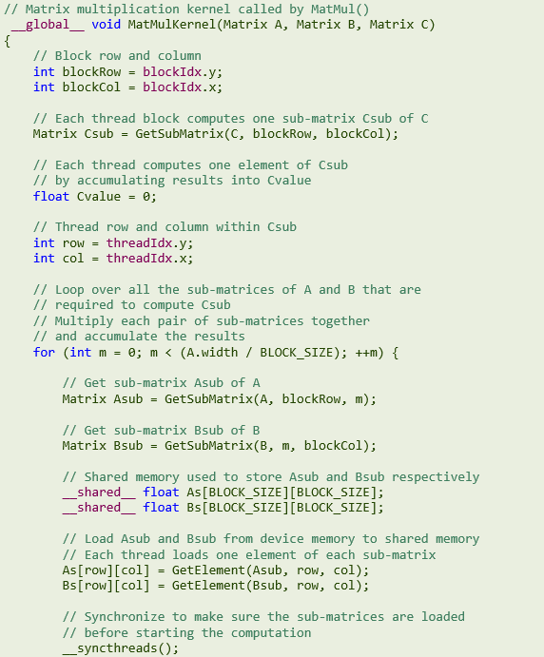
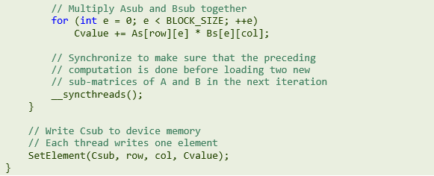
Matrix Multiplication using Shared Memory
Matrix Multiplication function

Slide 21
Matrix Multiplication using Shared Memory
Full code : refer “CUDA C Programming guide”

Slide 22
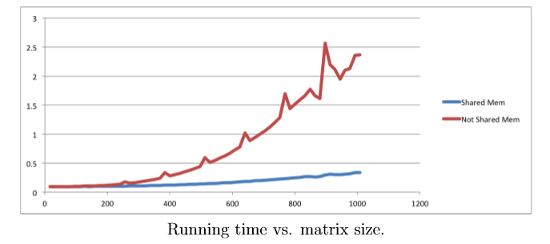
Performance Comparison
NVIDIA GeForce GT 9600M in a MacBook Pro Laptop, 4 multiprocessors, 32 cores

Slide 23
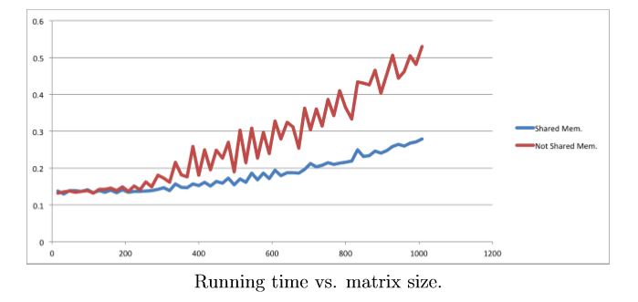
Performance Comparison
NVIDIA GeForce GT 330M in a MacBook Pro Laptop, 6 multiprocessors, 48 cores

Slide 24
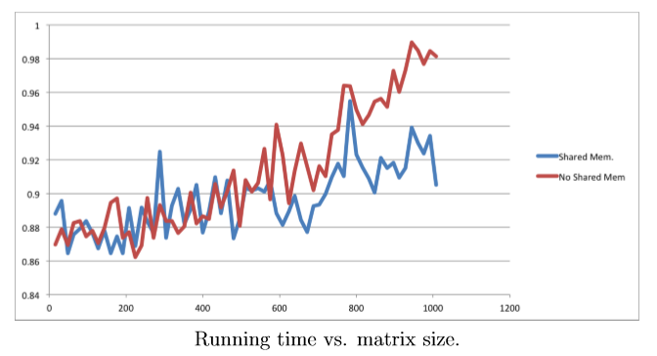
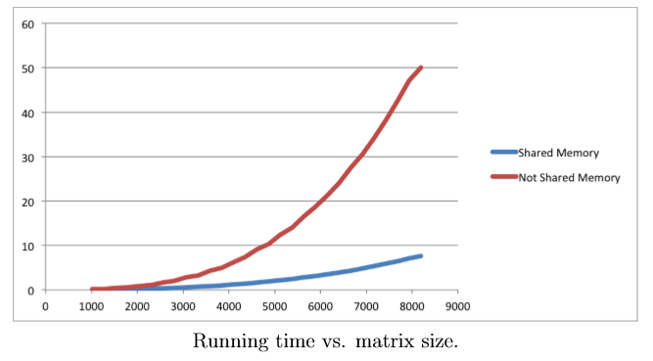
Performance Comparison
NVIDIA Tesla C1060 running in Earlham’s cluster, 30 multiprocessors, 240 cores

Slide 25
Conclusion
Proper use of shared memory can result higher execution speed

Slide 26
Thank you for listening

